Slide 1
CSC 112: Computer Operating Systems Lecture 4 Deadlocks Exercises
Department of Computer Science,
Hofstra University
Acknowledgement: Lecture slides based on UC Berkeley CS 162: Operating Systems and System Programming

Slide 2
Quiz: Deadlocks II
Is there a possible deadlock?
Yes, there is a deadlock. Consider the following interleaving:
thread 1 executes L1.wait(); no blocking
thread 2 executes L3.wait(); no blocking
thread 3 executes L2.wait(); no blocking
Now there is a circular wait condition:
thread 1 waiting for L2 (held by thr. 3) → thr. 2 waiting for L1 (held by thr. 1) → thr. 3 waiting for L3 (held by thr. 2).
Solution: each thread should acquire locks in the same order, say, L1, L2, L3.
1 Semaphore L1=1, L2=1, L3=1;
2
// Thread 1:
L1.wait();
L2.wait();
// critical section requiring L1 and L2 locked.
L2.post();
L1.post();
9
// Thread 2:
L3.wait();
L1.wait();
// critical section requiring L3 and L1 locked.
L1.post();
L3.post();
16
// Thread 3:
L2.wait();
L3.wait();
// critical section requiring L2 and L3 locked.
L3.post();
L2.post();

Slide 3
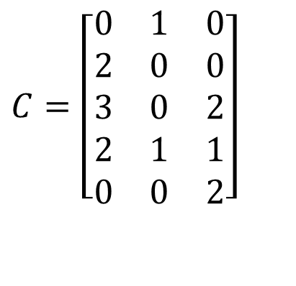
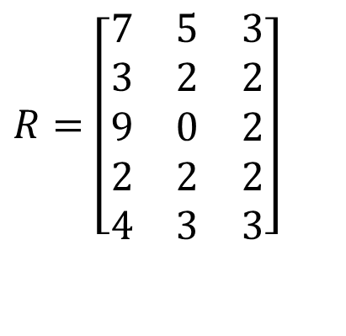

Quiz: Banker’s Algorithm I
4 processes P1 through P5; 3 resource types R1, R2, R3 with 7, 3, 6 instances each.
Run Banker’s algorithm to check if the current state is safe. If yes, give a safe sequence of process completions and fill in the table with the sequence of process completions without deadlock, and available resources after the completion of each process.
(You will be graded on “Need matrix”, and “Available resources after completion of each process”.)
Max
Allocation
$$R=\left[\begin{matrix}7 & 5 & 3 \\ 3 & 2 & 2 \\ 9 & 0 & 2 \\ 2 & 2 & 2 \\ 4 & 3 & 3\end{matrix}\right]$$
$$C=\left[\begin{matrix}0 & 1 & 0 \\ 2 & 0 & 0 \\ 3 & 0 & 2 \\ 2 & 1 & 1 \\ 0 & 0 & 2\end{matrix}\right]$$
Total
Available resources after completion of each process
$$E=\left[7\begin{matrix} & 3 & 6\end{matrix}\right]$$
 | R1 | R2 | R3
Init

Slide 4

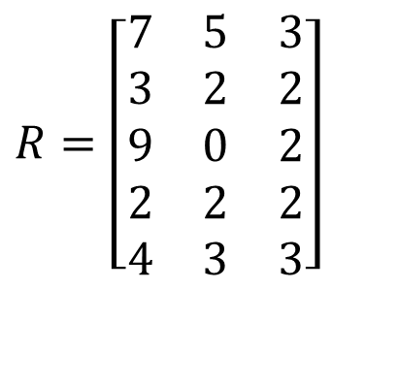


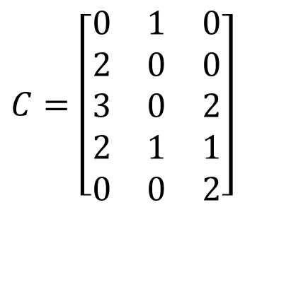
Quiz Solution: Banker’s Algorithm I
First compute the Need matrix as Max – Allocation, and Available vector A.
The state is not safe, the execution sequence P4, P2 leads to a deadlock state, where none of the remaining processes P1, P3, P5 can finish.
Available resources after completion of each process
Max
Allocation
Need
$$R=\left[\begin{matrix}7 & 5 & 3 \\ 3 & 2 & 2 \\ 9 & 0 & 2 \\ 2 & 2 & 2 \\ 4 & 3 & 3\end{matrix}\right]$$
$$C=\left[\begin{matrix}0 & 1 & 0 \\ 2 & 0 & 0 \\ 3 & 0 & 2 \\ 2 & 1 & 1 \\ 0 & 0 & 2\end{matrix}\right]$$
$$R−C=\left[\begin{matrix}7 & 4 & 3 \\ 1 & 2 & 2 \\ 6 & 0 & 0 \\ 0 & 1 & 1 \\ 4 & 3 & 1\end{matrix}\right]$$
 | R1 | R2 | R3
Init | 0 | 1 | 1
P4 | 2 | 2 | 2
P2 | 4 | 2 | 2
 | Deadlock
Total
Available
$$E=\left[7\begin{matrix} & 3 & 6\end{matrix}\right]$$
$$A=\left[0\begin{matrix} & 1 & 1\end{matrix}\right]$$
Your task

Slide 5

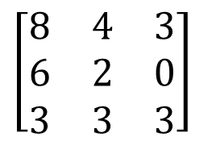
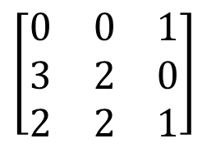
Quiz: Banker’s algorithm II
4 processes P1, P2, P3; 3 resource types R1, R2, R3 with 8, 6, 4 instances each.
1) Run Banker’s algorithm to check if the current state is safe. If yes, give a safe sequence of process completions and fill in the table with the sequence of process completions without deadlock, and available resources after the completion of each process.
2) Starting from the initial state, if P1 makes request for 2 more instances of resource 3, should we grant it?
3) Starting from the initial state, if P2 makes request for 2 more instances of resource 1, should we grant it?
Max
Allocation
$$\left[\begin{matrix}8 & 4 & 3 \\ 6 & 2 & 0 \\ 3 & 3 & 3\end{matrix}\right]$$
$$\left[\begin{matrix}0 & 0 & 1 \\ 3 & 2 & 0 \\ 2 & 2 & 1\end{matrix}\right]$$
Total
$$E=\left[8\begin{matrix} & 6 & 4\end{matrix}\right]$$
Available resources after completion of each process
 | R1 | R2 | R3
Init

Slide 6

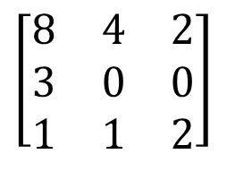
Quiz Solution: Banker’s algorithm II
The initial state is safe, with safe sequences of P2, P3, P1 or P2, P2, P1
Max
Allocation
Need
$$\left[\begin{matrix}8 & 4 & 3 \\ 6 & 2 & 0 \\ 3 & 3 & 3\end{matrix}\right]$$
$$\left[\begin{matrix}0 & 0 & 1 \\ 3 & 2 & 0 \\ 2 & 2 & 1\end{matrix}\right]$$
$$\left[\begin{matrix}8 & 4 & 2 \\ 3 & 0 & 0 \\ 1 & 1 & 2\end{matrix}\right]$$
Total
Available
$$E=\left[8\begin{matrix} & 6 & 4\end{matrix}\right]$$
$$E=\left[3\begin{matrix} & 2 & 2\end{matrix}\right]$$
Available resources after completion of each process
Available resources after completion of each process
 | R1 | R2 | R3
Init | 3 | 2 | 2
P2 | 6 | 4 | 2
P3 | 8 | 6 | 3
P1 | 8 | 6 | 4
 | R1 | R2 | R3
Init | 3 | 2 | 2
P3 | 5 | 4 | 3
P2 | 8 | 6 | 3
P1 | 8 | 6 | 4
Or

Slide 7

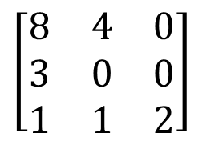
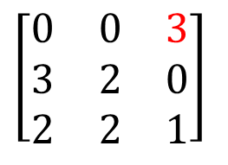
Quiz Solution: Banker’s algorithm II
Starting from the initial state, if P1 makes request for 2 more instances of resource 3, then we calculate the state of the system if this request is fulfilled.
The state is unsafe, so we deny this request.
Max
Allocation
Need
$$\left[\begin{matrix}8 & 4 & 3 \\ 6 & 2 & 0 \\ 3 & 3 & 3\end{matrix}\right]$$
$$\left[\begin{matrix}0 & 0 & 3 \\ 3 & 2 & 0 \\ 2 & 2 & 1\end{matrix}\right]$$
$$\left[\begin{matrix}8 & 4 & 0 \\ 3 & 0 & 0 \\ 1 & 1 & 2\end{matrix}\right]$$
Total
Available
$$E=\left[8\begin{matrix} & 6 & 4\end{matrix}\right]$$
$$E=\left[3\begin{matrix} & 2 & 0\end{matrix}\right]$$
Available resources after completion of each process
 | R1 | R2 | R3
Init | 3 | 2 | 0
P2 | 6 | 4 | 0
 | Deadlocked

Slide 8

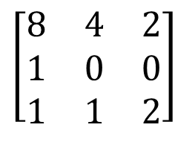
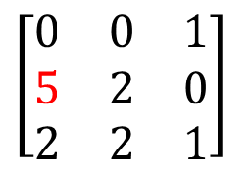
Quiz Solution: Banker’s algorithm II
Starting from the initial state, if P2 makes request for 2 more instances of resource 1, then we calculate the state of the system if this request is fulfilled.
The state is safe, with safe sequences of P2, P3, P1 or P2, P2, P1, so we can grant this request.
Max
Allocation
Need
$$\left[\begin{matrix}8 & 4 & 3 \\ 6 & 2 & 0 \\ 3 & 3 & 3\end{matrix}\right]$$
$$\left[\begin{matrix}0 & 0 & 1 \\ 5 & 2 & 0 \\ 2 & 2 & 1\end{matrix}\right]$$
$$\left[\begin{matrix}8 & 4 & 2 \\ 1 & 0 & 0 \\ 1 & 1 & 2\end{matrix}\right]$$
Total
Available
$$E=\left[8\begin{matrix} & 6 & 4\end{matrix}\right]$$
$$E=\left[1\begin{matrix} & 2 & 2\end{matrix}\right]$$
Available resources after completion of each process
Available resources after completion of each process
 | R1 | R2 | R3
Init | 1 | 2 | 2
P2 | 6 | 4 | 2
P3 | 8 | 6 | 3
P1 | 8 | 6 | 4
 | R1 | R2 | R3
Init | 1 | 2 | 2
P3 | 3 | 4 | 3
P2 | 8 | 6 | 3
P1 | 8 | 6 | 4
Or

Slide 9

Banker’s Algorithm: 4 philosophers each holding his left fork
Max
Allocation
Need
0
1
0
1
$$R−C$$
0
1
0
1
1
1
Available resources after completion of each process
Total
Available
 | R1 | R2 | R3 | R4 | R5
 | 0 | 0 | 0 | 0 | 1
Suppose we have 5 philosophers P1-P5, and 5 forks R1-R5; philosopher Pi has left fork Ri, and right fork R(i+1)%5. Philosophers P1-P4 each is holding his left fork.
Run Banker’s algorithm to check if the current state is safe. If yes, give a safe sequence of process completions and fill in the table with the sequence of process completions without deadlock, and available resources after the completion of each process.

Slide 10
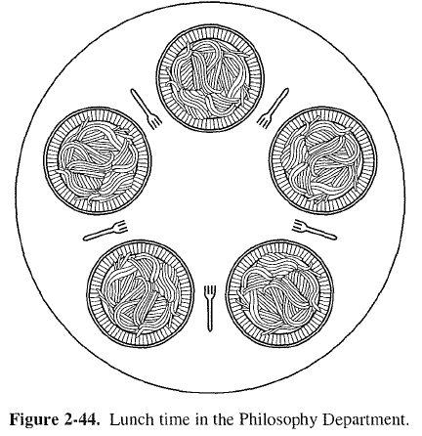
Banker’s Algorithm: 4 philosophers each holding his left fork ANS
Yes, current state is safe, and the only safe sequence is P4, P3, P2, P1, P5
P4
R5
R4
Available resources after completion of each process
P5
P3
 | R1 | R2 | R3 | R4 | R5
 | 0 | 0 | 0 | 0 | 1
P4 | 0 | 0 | 0 | 1 | 1
P3 | 0 | 0 | 1 | 1 | 1
P2 | 0 | 1 | 1 | 1 | 1
P1 | 1 | 1 | 1 | 1 | 1
P5 | 1 | 1 | 1 | 1 | 1
R1
R3
P1
R2
P2
Notes:
https://people.eecs.berkeley.edu/~kubitron/courses/cs162-F07/exams/fa07mt1-solutions.pdf
The lawyers are so busy talking that they can only grab one chopstick at a time. Design a deadlock-free algorithm using monitors and Bankers algorithm.

Slide 11
Banker’s Algorithm: 5 philosophers each holding his left fork
Max
Allocation
Need
0
1
0
1
0
1
0
1
1
Total
Available
Run Banker’s algorithm to check if the current state is safe.
ANS: It is not safe, as no process can run to completion based on Need matrix and Available vector.

Slide 12
Multi-Armed Lawyers
Consider a large table with identical multi-armed alien lawyers. There is a pile of chopsticks at the center of the table. In order to eat, a lawyer must have one chopstick in each hand. Assume total number of chopsticks >= number of hands of each lawyer, so at least one lawyer can eat.
It is not a generalization of the 2-armed Dining Philosophers problem. Since the chopsticks are in a pile at center of the table, we should model them as a single resource with multiple instances, instead of multiple resources for the Dining Philosophers, where each fork (chopstick) has a fixed position in-between two philosophers. Hence the R and C matrices have a single column.
Ack: this example is taken from UC Berkeley CS162 course.
Notes:
https://people.eecs.berkeley.edu/~kubitron/courses/cs162-F07/exams/fa07mt1-solutions.pdf
The lawyers are so busy talking that they can only grab one chopstick at a time. Design a deadlock-free algorithm using monitors and Bankers algorithm.

Slide 13
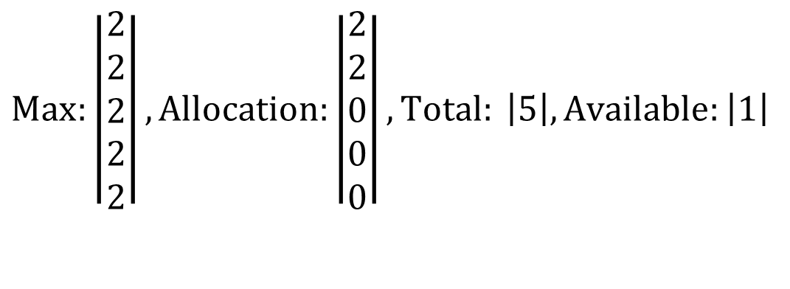
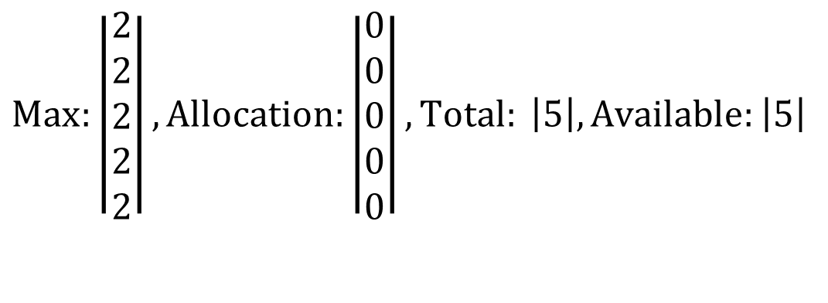
Example: 5 Lawyers, each with 2 arms, 5 chopsticks
$$Max:\left|\begin{matrix}2 \\ 2 \\ 2 \\ 2 \\ 2\end{matrix}\right|, Allocation:\left|\begin{matrix}0 \\ 0 \\ 0 \\ 0 \\ 0\end{matrix}\right|, Total: \left|5\right|, Available:\left|5\right|$$
Initially, all chopsticks are free.
$$Max:\left|\begin{matrix}2 \\ 2 \\ 2 \\ 2 \\ 2\end{matrix}\right|, Allocation:\left|\begin{matrix}2 \\ 2 \\ 0 \\ 0 \\ 0\end{matrix}\right|, Total: \left|5\right|, Available:\left|1\right|$$
Two lawyers each grab two chopsticks and start eating. No other lawyers can eat.

Slide 14
Quiz: Dining Lawyers I
If each lawyer has 2 arms, and there is a pile of chopsticks at the center of the table. Assume there are at least 2 chopsticks, so at least one lawyer can eat. Each lawyer follows the following steps:
(1) Pick up a chopstick
(2) Pick up another chopstick
(3) Eat
(4) Return both chopsticks to the pile
Q: Can the system be deadlocked?

Slide 15
Quiz: Dining Lawyers I Answer
ANS: No deadlocks, since there is only one type of resource, so it is not possible to have circular waiting.
Notes:
A

Slide 16
Quiz: Dining Lawyers II
If each lawyer has 2 arms, and there is a pile of knives and forks at center of the table. Assume there are at least 1 knife and 1 fork, so at least one lawyer can eat. Each lawyer follows the following steps:
(1) Pick up a knife
(2) Pick up a fork
(3) Eat
(4) Return the knife and fork to the pile
Q: Can the system be deadlocked?

Slide 17
Quiz: Dining Lawyers II Answer
ANS: No deadlocks, since it’s not possible to have circular waiting.
All lawyers follow the same resource acquisition order:
1. Knife
2. Fork
Since lawyers do not wait for resources held by others in a cyclic manner, no circular dependency forms.
Example: If all knives are taken, lawyers without knives wait for returned knives. Those with knives either acquire forks (if available) or wait for forks to be returned. With at least one fork in the system, progress is guaranteed once utensils are released.
Resource 2 (a knife) held by Thread 2
1 knife
Resource 2 (a knife) requested by Thread 2
P1
P2
Resource 1 (a fork) requested by Thread 2
1 fork
Resource 1 (a fork) held by Thread 2
This deadlock scenario is not possible under the fixed resource acquisition order: 1. Knife 2. Fork
Notes:
A

Slide 18
Quiz: Dining Lawyers III
If each lawyer has 4 arms, and there is a pile of knives and forks at center of the table. Assume there are at least 2 knives and 2 forks, so at least one lawyer can eat. Each lawyer follows the following steps:
(1) Pick up 2 knives atomically
(2) Pick up 2 forks atomically
(3) Eat
(4) Return the knives and forks to the pile
Q: Can the system be deadlocked?

Slide 19
Quiz: Dining Lawyers III Answer
ANS: No deadlocks, since it’s not possible to have circular waiting.
All lawyers follow the same resource acquisition order:
1. Two knives
2. Two forks
Since lawyers do not wait for resources held by others in a cyclic manner, no circular dependency forms.
Resource 2 (2 knives) held by Thread 2
2 knives
Resource 2 (2 knives) requested by Thread 2
P1
P2
Resource 1 (2 forks) requested by Thread 2
2 forks
Resource 1 (2 forks) held by Thread 2
This deadlock scenario is not possible under the fixed resource acquisition order: 2 knives, 2 forks
Notes:
A

Slide 20
Quiz: Dining Lawyers III
If each lawyer has 4 arms, and there is a pile of knives and forks at center of the table. Assume there are at least 2 knives and 2 forks, so at least one lawyer can eat. Each lawyer follows the following steps:
(1) Pick up a knife
(2) Pick up another knife
(3) Pick up a fork
(4) Pick up another fork
(5) Eat
(6) Return the knife and fork to the pile
Q1: Can the system be deadlocked?
Q2: What if each lawyer may have a different number of arms, and may request a different ratio of knives vs. forks?

Slide 21
Quiz: Dining Lawyers III Answer
ANS1: Yes, since requests for each resource type (knife or fork) are not granted atomically. Need Banker’s algorithm to detect (potential) deadlocks.
Consider 2 lawyers, and a total of 2 knives and 2 forks available. If each lawyer picks up a knife, the system is deadlocked.
Recall: “Define a total order of resources; If a thread holds certain resources, it can subsequently request only resources that follow the types of held resources in the total order.” Since all knives are the same and not numbered, you cannot form a total order like “request knife 1 before knife 2”. If a lawyer requests a knife while holding a knife, there may be circular waiting.
ANS2: The solution is basically the same, except implementation of Banker’s algorithm needs to take into account this factor, e.g., have an array of variables NumArms[] instead of a single variable NumArms, and so on.
Resource 2 (a knife) held by Thread 2
1 knife
Resource 2 (a knife) requested by Thread 2
P1
P2
Resource 1 (a knife) requested by Thread 2
1 knife
Resource 1 (a knife) held by Thread 2
This deadlock scenario is possible under the resource acquisition order: a knife, a knife, a fork, a fork.
Notes:
A: The solution is basically the same, except implementation of Banker’s algorithm needs to take into account this factor, e.g., have an array of variables NumArms[] instead of a single variable NumArms, and so on.

